Slide 1





The Health Squad Presents:
AI-INTEGRATED FILE ACCESS AND PATIENT MANAGEMENT SOFTWARE
LINDOKUHLE MALEVU
NATASHA SIBANDA
LEHLOGONOLO MPHAKI
REFILWE SELAMOLELA
TH SQUAD
SEIPATI MATSUNYANE
TH SQUAD

Slide 2


PROBLEM STATEMENT, GCGO AND OUR WHY
One of the major challenges South Africa is facing today in public healthcare facilities is overcrowding and long waiting times especially at the reception or front desk area.
Therefore, our chosen Global Challenge - Global Opportunity is HEALTH CARE.
WHY OUR PROBLEM MATTERS?
Long queues in hospitals need to be addressed to prevent delayed treatment, worsening health conditions, and reduced patient satisfaction. Timely care and efficient service can improve health outcomes and overall patient experience.

Slide 3


AFFECTED PERSON/ GROUP
The core issue lies in the inefficiency, inaccessibility, and inequality of healthcare services, particularly in the public sector, which serves approximately 80% of the population. A stark contrast exists between the public and private healthcare sectors, with the latter offering high-quality services that are unaffordable for many. Rural areas are disproportionately affected, with about 70% of the population relying on public healthcare services that are often under-resourced and understaffed.

Slide 4
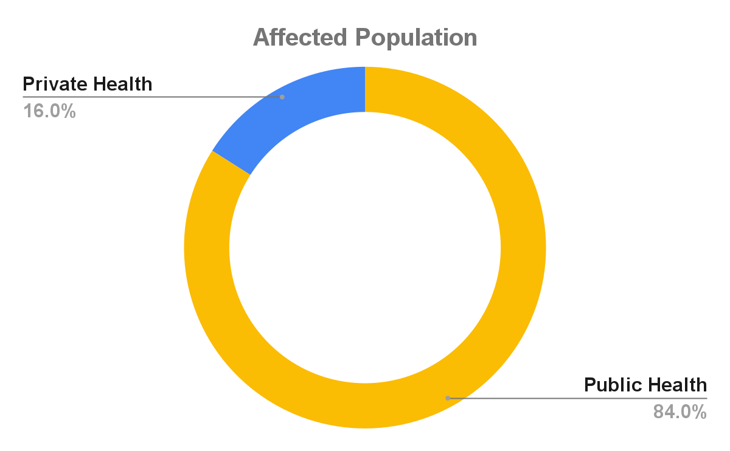

VISUALISATION 1
The majority of the population, some 84%, uses public health facilities, while 16% are covered by medical schemes, enabling them to access private health care facilities.

Slide 5
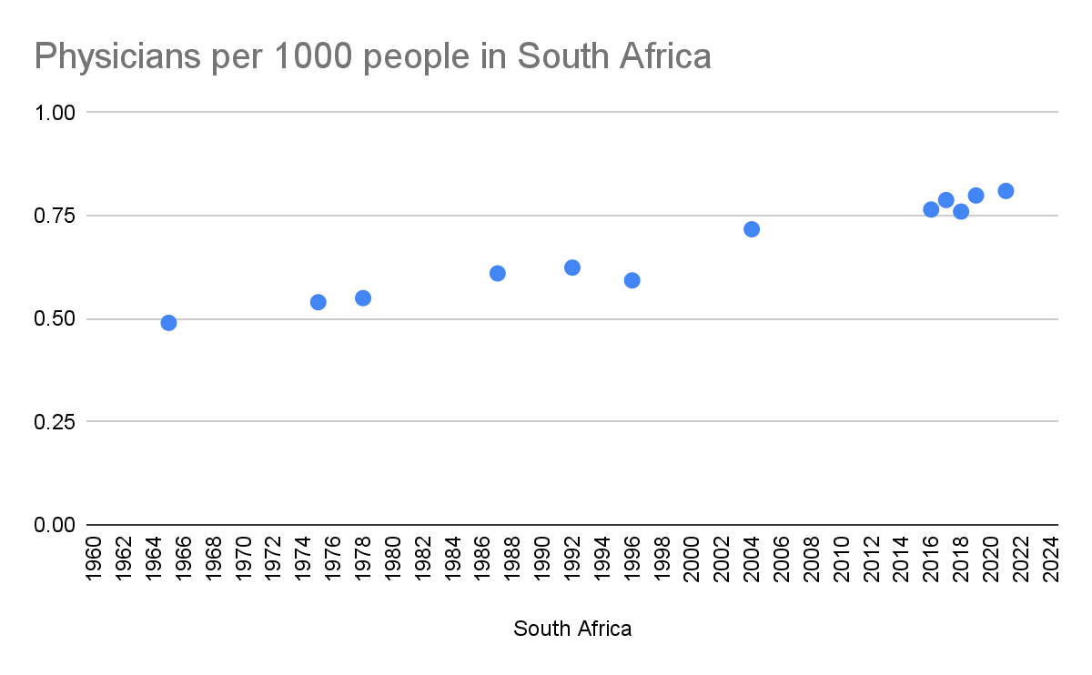
VISUALISATION 2
Physicians (per 1,000 people) - South Africa.
Physicians include generalist and specialist medical practitioners. The WHO estimates that at least 2.5 medical staff (physicians, nurses and midwives) per 1,000 people are needed to provide adequate coverage with primary care interventions (WHO, World Health Report 2006)

Slide 6
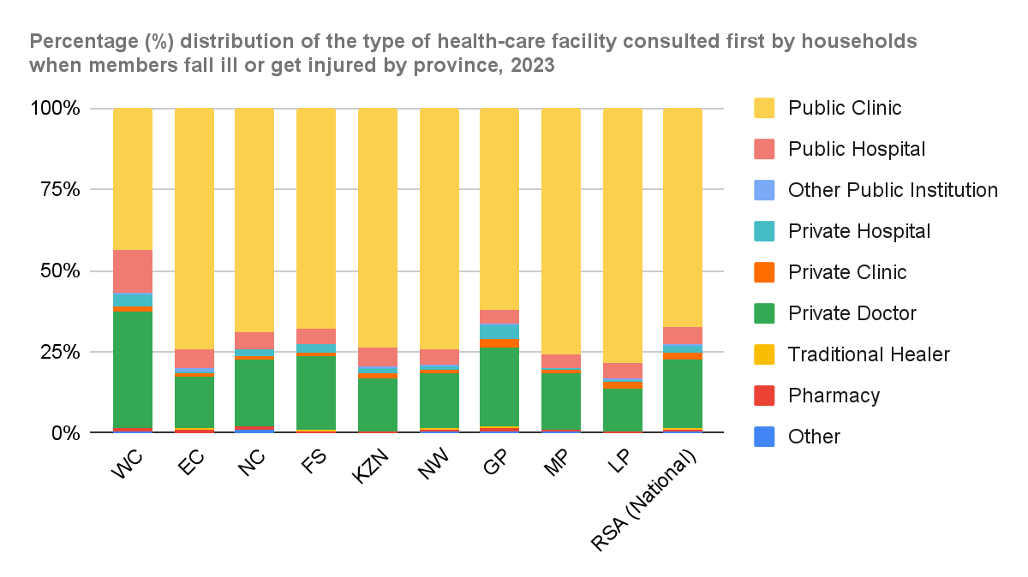
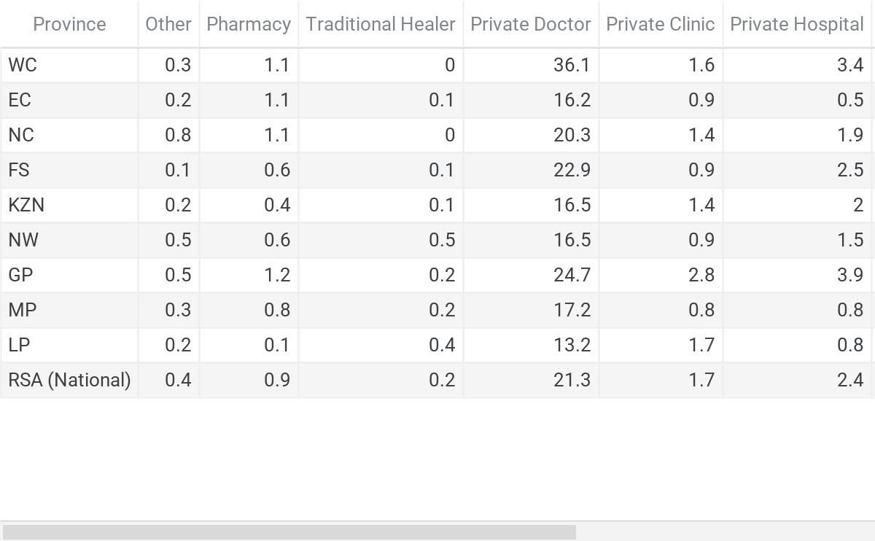
VISUALISATION 3

Slide 7
PROBLEM STATEMENT, GCGO AND OUR WHY
Our proposed solution is an AI-Integrated file management and patient system, designed for all South African public hospitals and clinics. It allows a very seamless patient checks-in, real-time file digital file retrieval using every patients ID/Passport scanning, smart Medicare AI, smart triage using AI and automated file updates.
WHY WE CHOSE THIS SOLUTION?
We chose this solution because our main goal is to address the overcrowding and long reception wait time, with this solution it lowers that, it improves efficiency by reducing the use of physical files by nurses, doctors and admin staff. It uses technology which enables it to have fast, data driven medical decisions through instant access to patient history. It is a very scalable, uses 9 different languages and can be easily adaptable to the South African public healthcare environment.
WHY IS IT EFFECTIVE?
It uses AI to detect recurring conditions and immediately assign emergency care. It simplifies check-ins using the ID/Passport scanning. It allows healthcare professionals to medically assist patients quicker than before. It reduces the loss of file and any medical records.

Slide 8
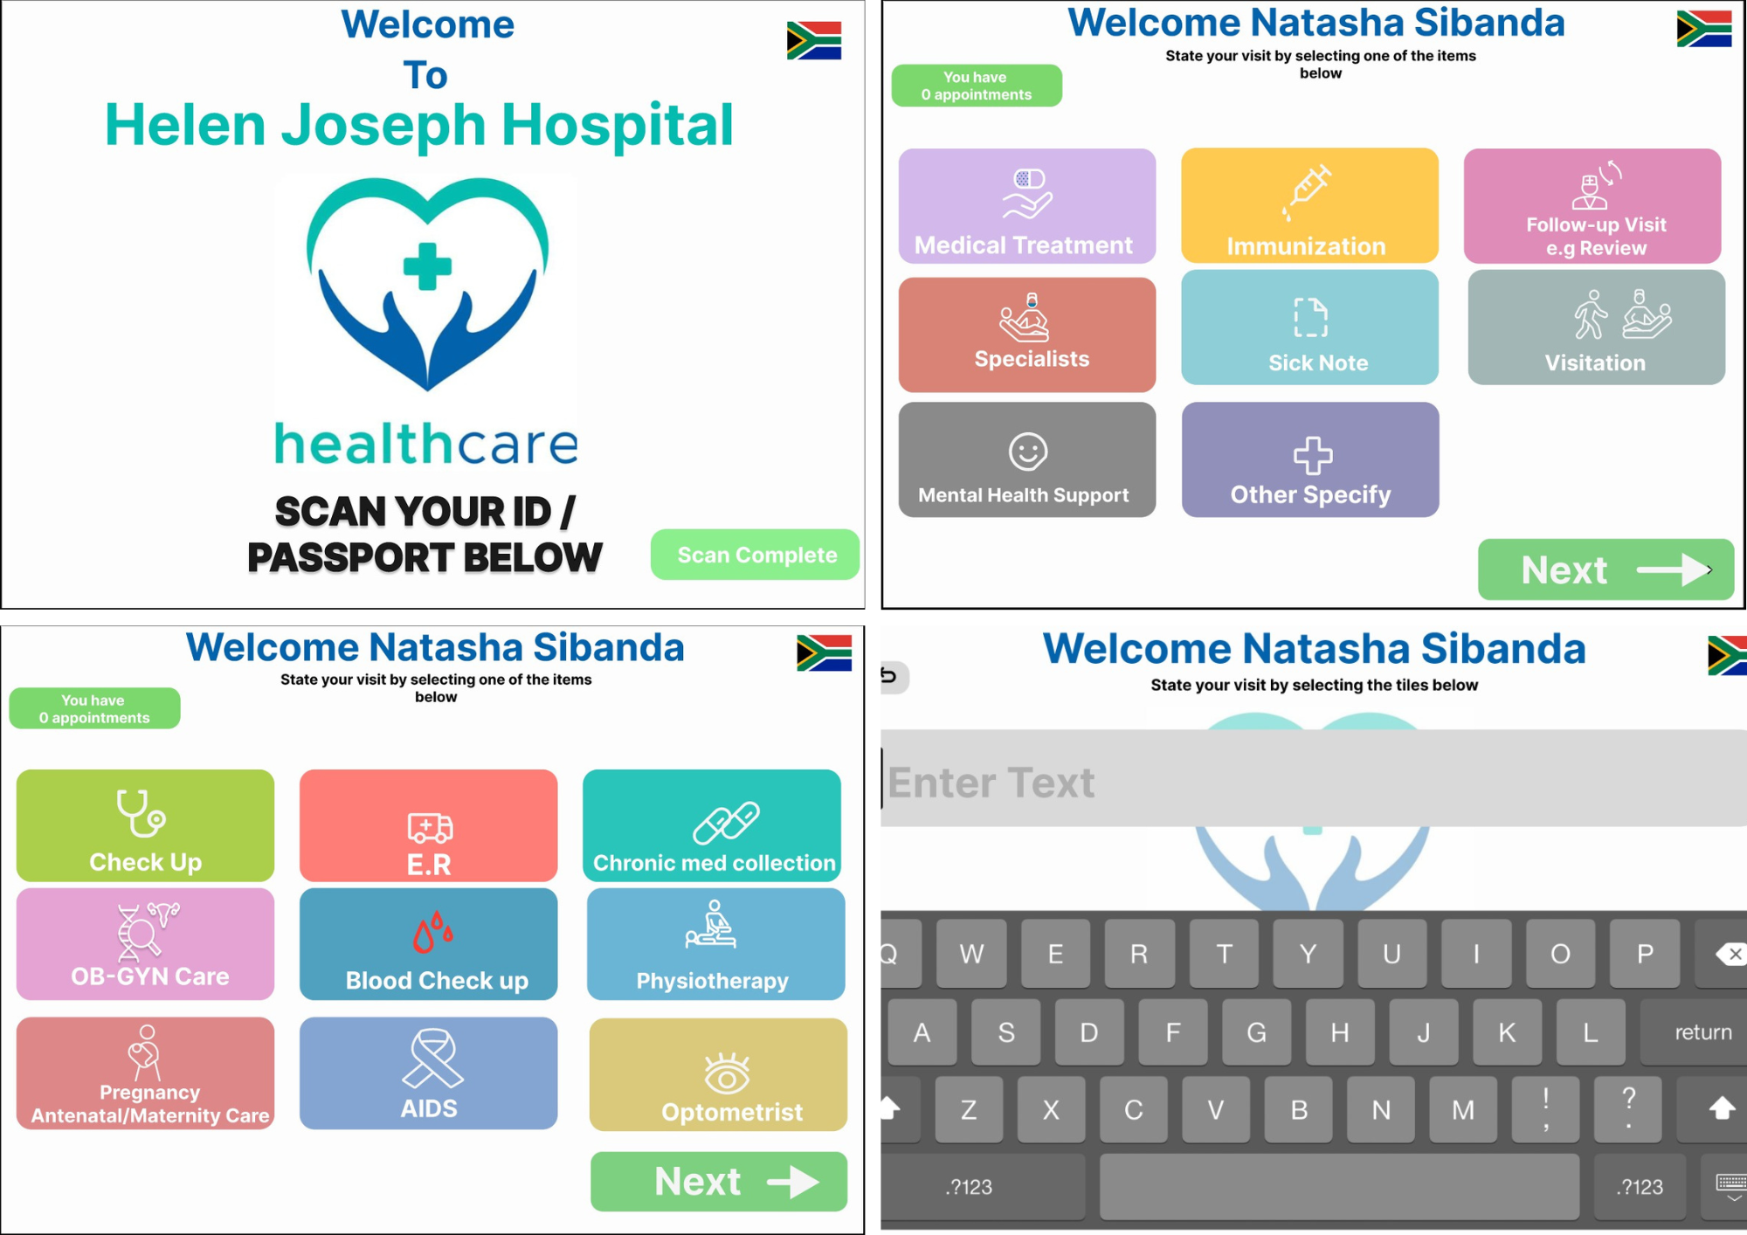
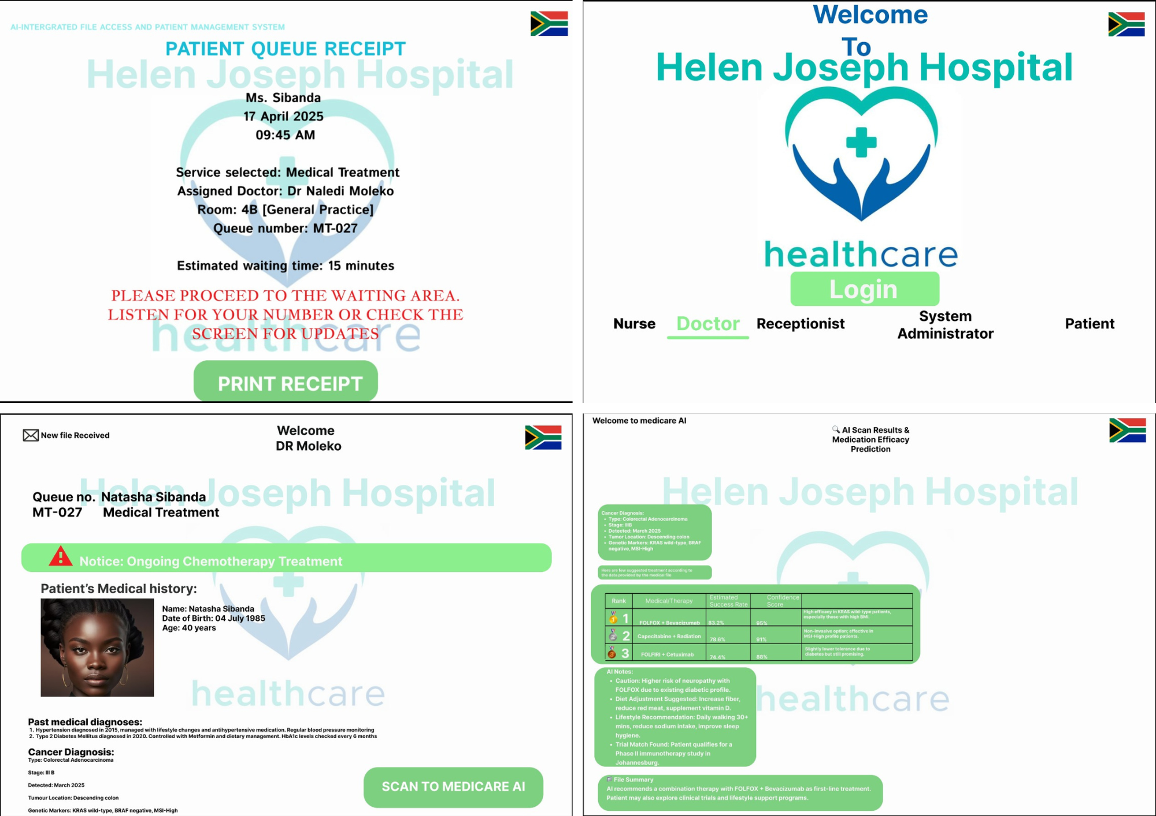
WIREFRAME SCREENS

Slide 9
OUR PAIN POINTS
1. Administrative Burden and Inefficiency
Excessive paperwork, manual data entry, and regulatory demands take time away from patient care, leading to errors, misplaced information, and overwhelmed healthcare staff.
2. Limited Access and Compromised Patient Care
A shortage of healthcare professionals, long wait times for specialist appointments, and the complexity of managing chronic illnesses and medications negatively impact treatment quality and patient safety.

Slide 10

RECOMMENDATIONS FROM TEST USERS
The screen with the list of options could use a bit more explanation or icons, just something to help the users understand what each button does quickly. A helpful button might be useful. Also, something like a log out or home button that's always visible would be helpful to users who might get lost.

Slide 11
WHAT’S NEXT?
1. Team Expansion: Hire AI engineers, healthcare IT experts, and compliance/legal advisors.
2. Product Development: Finalize and enhance core features, AI models, and user interface.
3. Secure Infrastructure: Set up HIPAA/GDPR-compliant cloud systems with robust data security.
4. Pilot Testing: Partner with clinics/hospitals to test the software in real-world settings and gather feedback.
5. Regulatory Compliance: Work toward certifications and ensure full legal and data governance compliance.
6. MVP Launch: Release a minimum viable product to early users and refine based on performance and feedback.
7. Go-to-Market & Scaling: Initiate marketing campaigns, build partnerships, and expand to additional healthcare providers.

Slide 12
KNOW OUR WHY
Our solution could make a major difference because it helps streamline workflows, reduce human errors and improve decision-making in healthcare by automatically organising and retrieving patient records, suggesting possible diagnosis and even predicting health risks. AI saves time for healthcare providers and enhances patient care. It also ensures more accurate, real time data access, which can lead to quicker and more informed medical decisions.
Team video link:

Slide 13
SLIDE 12
1. Team Expansion: Hire AI engineers, healthcare IT experts, and compliance/legal advisors.
2. Product Development: Finalize and enhance core features, AI models, and user interface.
3. Secure Infrastructure: Set up HIPAA/GDPR-compliant cloud systems with robust data security.
4. Pilot Testing: Partner with clinics/hospitals to test the software in real-world settings and gather feedback.
5. Regulatory Compliance: Work toward certifications and ensure full legal and data governance compliance.
6. MVP Launch: Release a minimum viable product to early users and refine based on performance and feedback.
7. Go-to-Market & Scaling: Initiate marketing campaigns, build partnerships, and expand to additional healthcare providers.

